Slide 1
Git – First Steps
Moritz Flüchter

Slide 2
Content
Creating a repository
Making and saving changes
Notes:
Say, first three steps are very thourough since important to understand everything
Most used commands, basics that are needed
After that, bit more relaxed, information around it

Slide 3
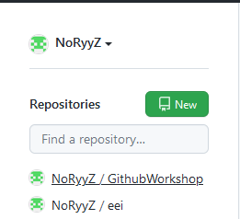
Creating a repository

Slide 4
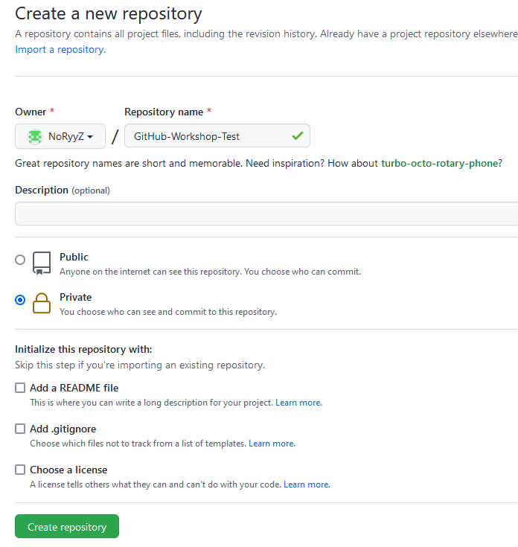
Creating a repository

Slide 5
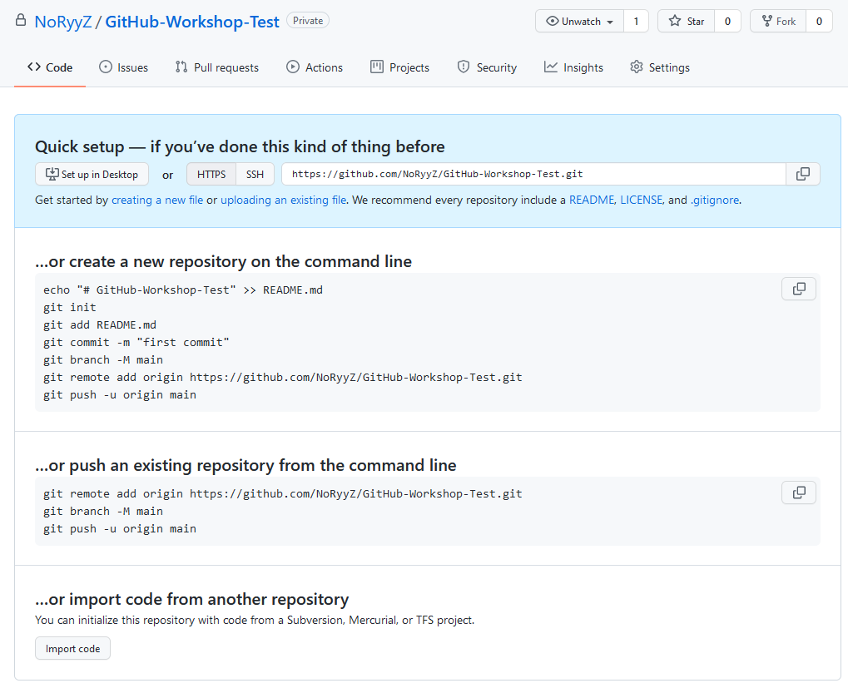
Creating a repository
Common method

Slide 6
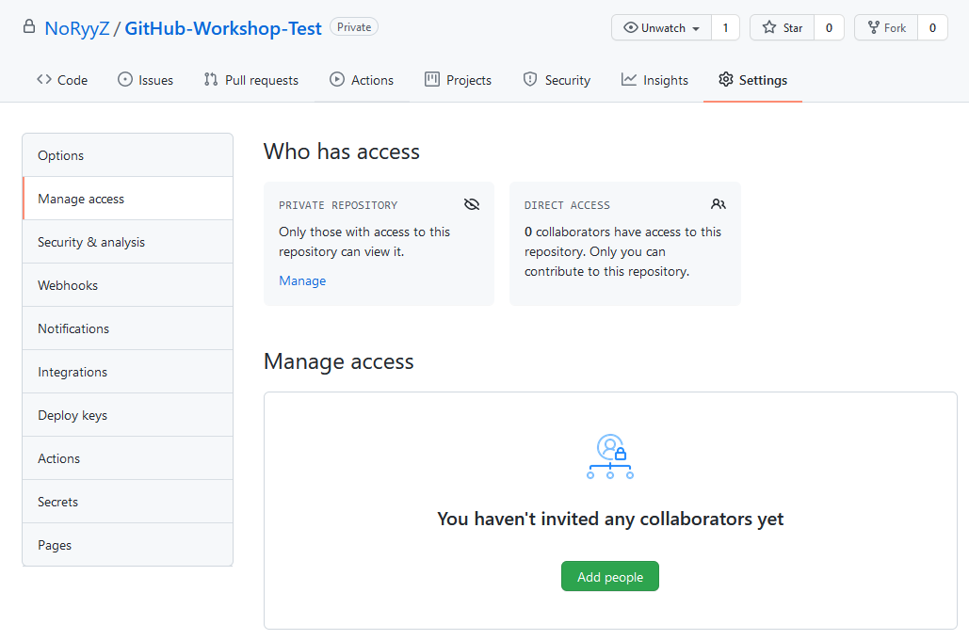
Creating a repository – Adding People
Notes:
Kurz eingeschoben, bevor es vergessen wird

Slide 7
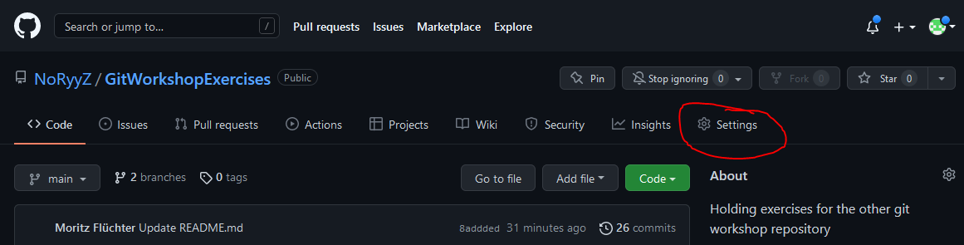
Personal Access Tokens
Used instead of a password!
Notes:
Kurz eingeschoben, bevor es vergessen wird

Slide 8
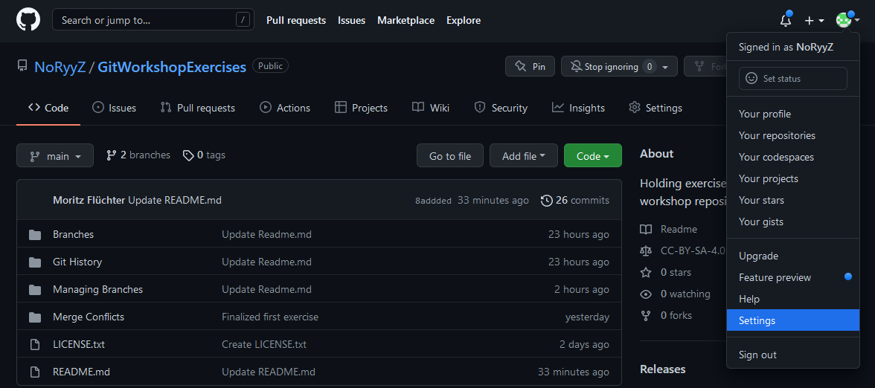
Personal Access Tokens
Used instead of a password!
Notes:
Kurz eingeschoben, bevor es vergessen wird

Slide 9
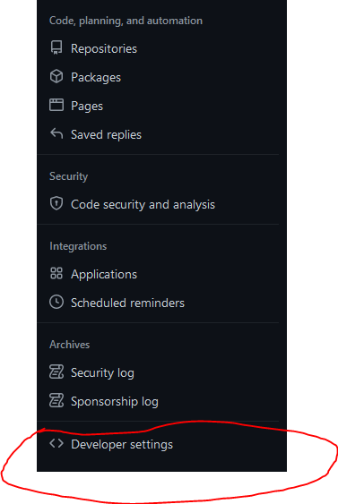
Personal Access Tokens
Notes:
Kurz eingeschoben, bevor es vergessen wird

Slide 10
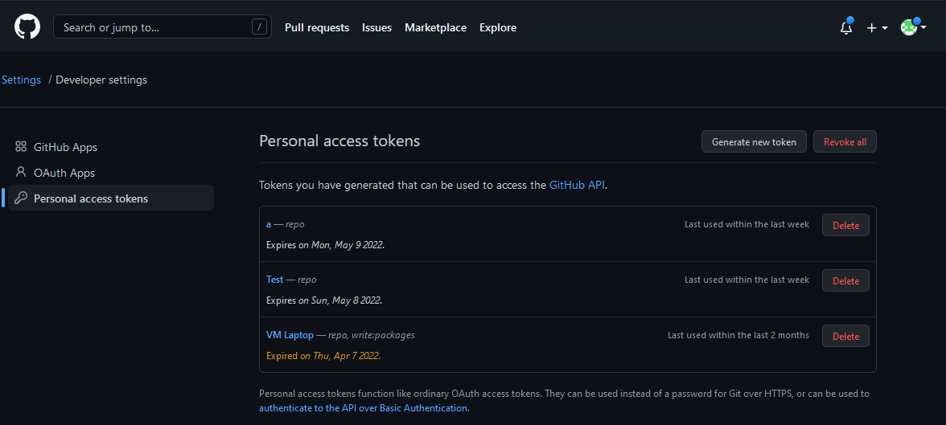
Personal Access Tokens
Notes:
Kurz eingeschoben, bevor es vergessen wird

Slide 11
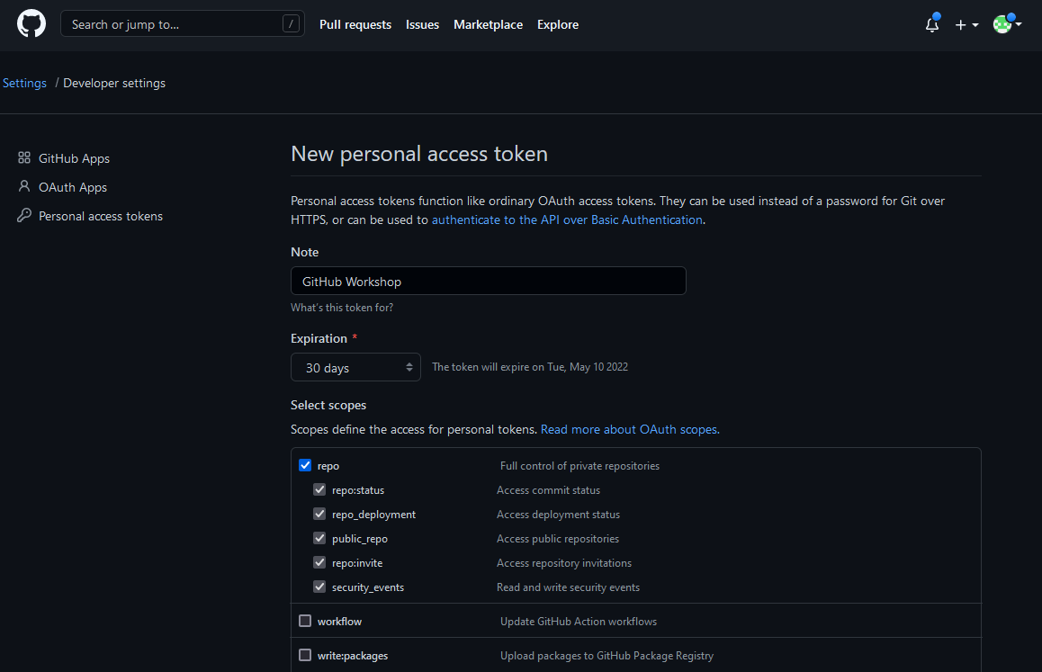
Personal Access Tokens
Notes:
Kurz eingeschoben, bevor es vergessen wird

Slide 12
Configuring git
$ git config --global user.email heinz.peter@abc.com
$ git config --global user.name “Heinz Peter"
Notes:
Kurz eingeschoben, bevor es vergessen wird

Slide 13
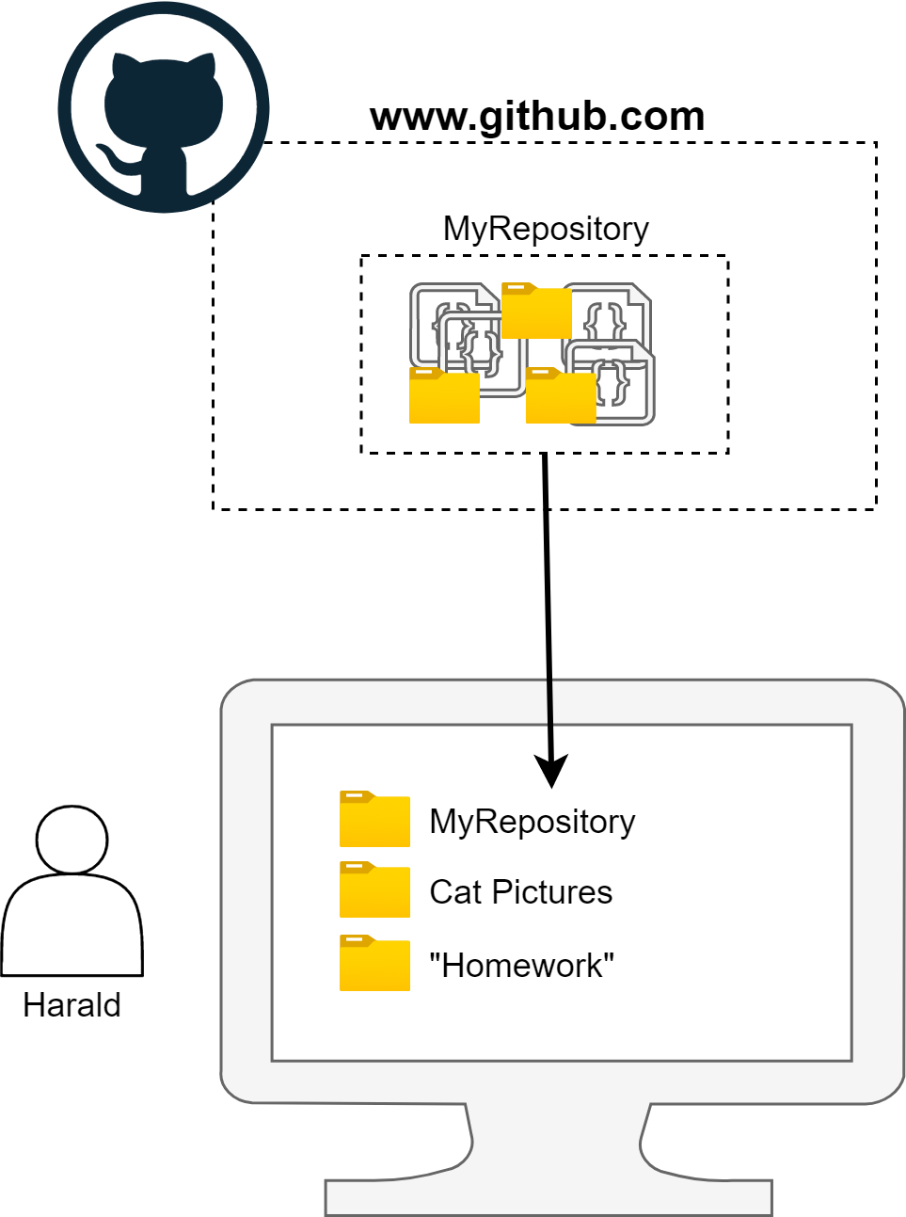
Fetching a repository – git clone
Initialize the repository on your computer
$ git clone [remote url]
Notes:
Say, this creates a new sub folder, everything in thuis subfolder will now be tracked

Slide 14
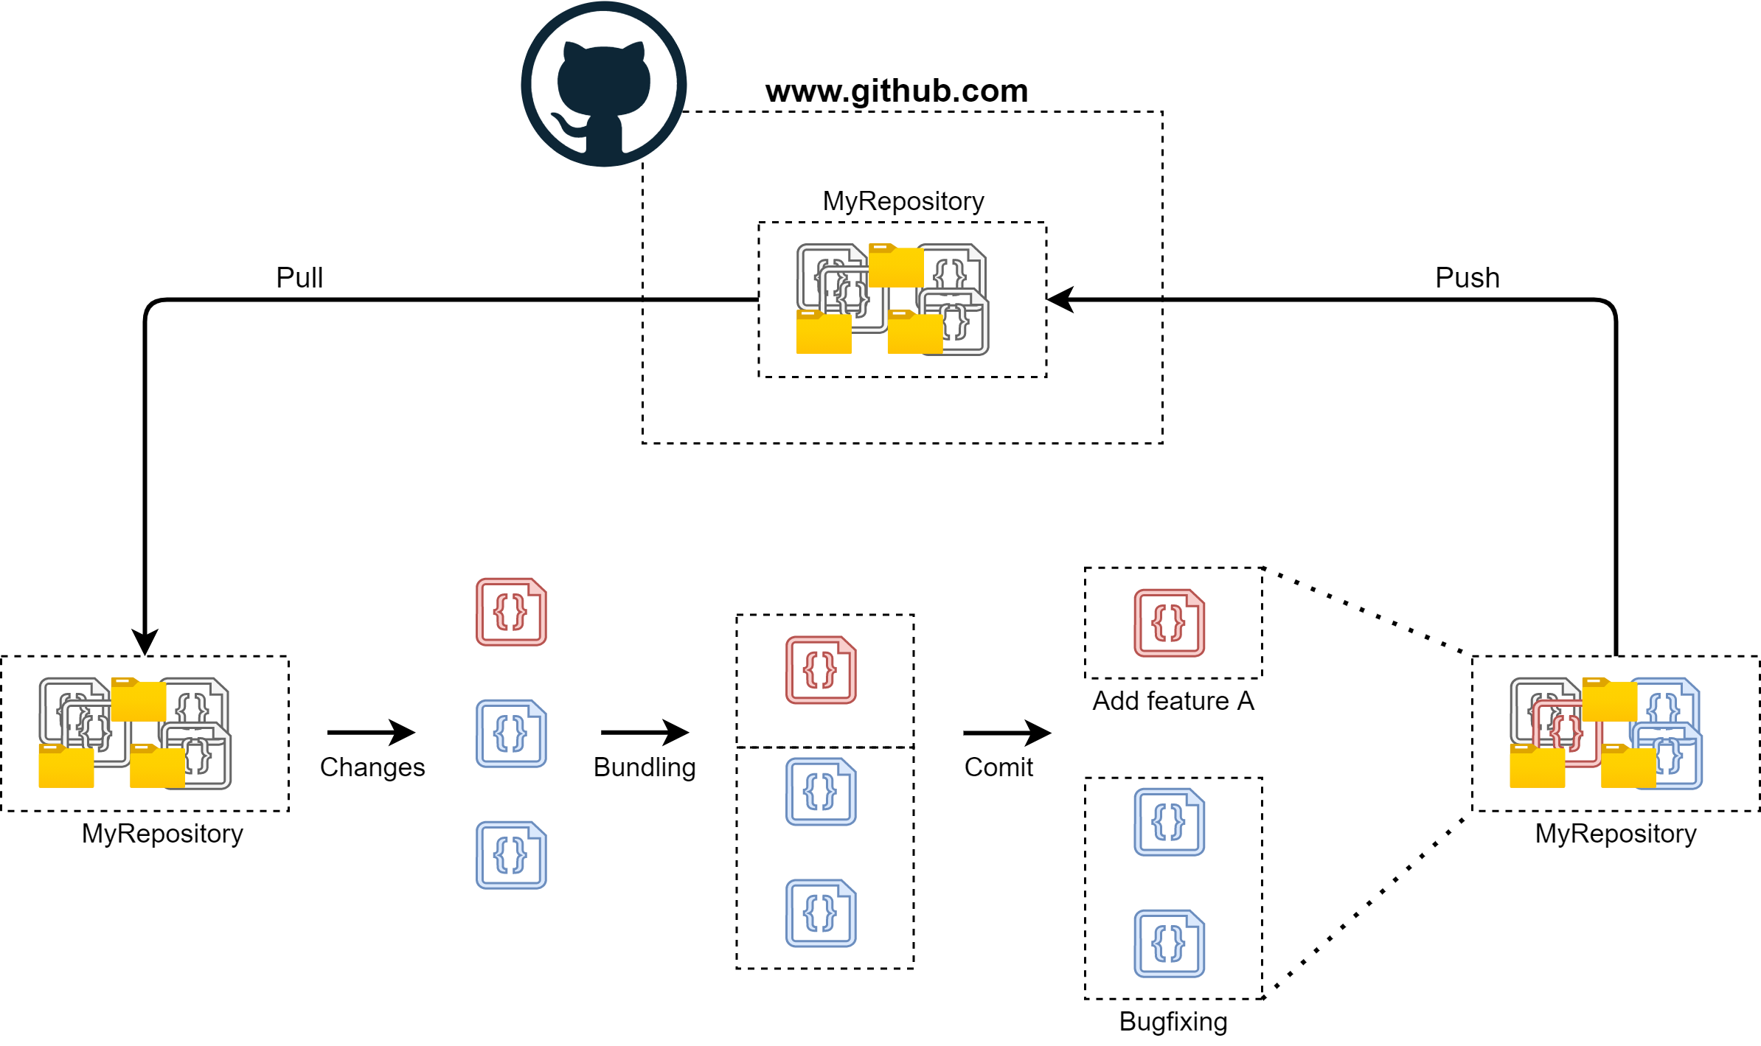
Making and saving changes

Slide 15
Making and saving changes
$ git pull
Gets the most recent version

Slide 16
Making and saving changes
You can always check the state of the local repository via:
$ git status

Slide 17
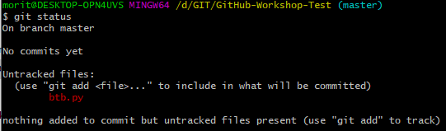
Making and saving changes
Now create any kind of file inside (or copy one into) the repository folder and type git status again:

Slide 18
Making and saving changes
$ git add [filename]
Adds a file to a change bundle

Slide 19
Making and saving changes
$ git reset [filename]
Removes a file from the current change bundle

Slide 20
Making and saving changes
$ git commit –m „[message]“
Finalizes the current change bundle

Slide 21
Making and saving changes
$ git push
Uploads all local change bundles

Slide 22
OLD
Notes:
Say, this creates a new sub folder, everything in thuis subfolder will now be tracked

Slide 23
Making and saving changes - Collaborating
Before making changes, the first step should always be to check github for updates if youre collaborating with other people.
$ git pull
Important: Git does not automatically check for changes on the remote (GitHub)!
Notes:
Say, this creates a new sub folder, everything in thuis subfolder will now be tracked

Slide 24
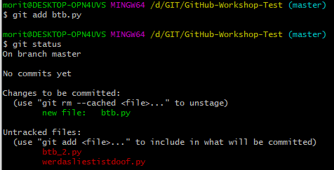
Making and saving changes
Adding changes to the commit bundle via:
$ git add [filename]

Slide 25
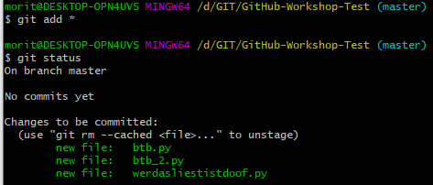
Making and saving changes
Adding all changes to the commit bundle via:
$ git add *

Slide 26
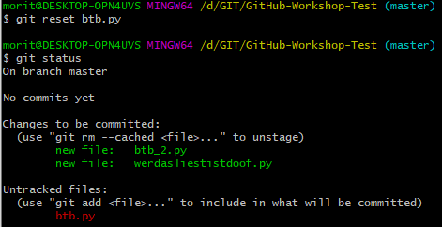
Making and saving changes
Removing changes to the commit bundle via:
$ git reset [filename]

Slide 27

Making and saving changes
After adding all files, create the commit via:
$ git commit –m „[message]“
(You can leave out –m [message], but then Git will use another way to force you to enter a message!)
Notes:
Say, this creates a new sub folder, everything in thuis subfolder will now be tracked

Slide 28
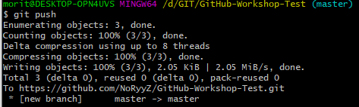
Making and saving changes
After commiting, we can push the changes to the remote via:
$ git push
(You can also first create multiple commits and then push them!)
Notes:
Say, this creates a new sub folder, everything in thuis subfolder will now be tracked

